Slide 1
Number Systems and Data in Computers
There are more, and better, ways to count than Decimal!

Slide 2

How do they count in Springfield?
0, 1, 2, 3, 4, 5, 6, 7
10, 11, 12, …. 17
20, 21, ….. 27
30 etc.
10 Simpsons equals our decimal eight, 27 Simpsons = decimal ?
Fractions: half = 0.4 of a Simpson
Quarter = 0.2 Simpson
Third (0.3333) = 0.375 Simpsons

Slide 3
‘History’ of Numbers
‘Natural` bases :
QUINARY (BASED ON 5)
DECIMAL (10)
DUODECIMAL (12)
VIGESIMAL (20)
60

Slide 4
Duodecimal system – Base 12
0, 1, 2, …. 9,
A, B,
10
11
12, ….., 19
1A
1B
20
As Decimal…
A is Decimal ten, B decimal eleven
10 is decimal twelve
1A is decimal 22
1B is decimal 23
20 is decimal 24

Slide 5
Duodecimal – Base 12
Decimal Fractions:
Half is 0.5
Quarter is 0.25
Third is 0.3333etc
Sixth is 0.16666etc
¾ is 0.75
Duodecimal Fractions:
1/2 is 0.6
Quarter is 0.3
Third is 0.4
Sixth is 0.2
¾ is 0.9

Slide 6
Evidence of other Number systems in our culture - 12
12 hours on clock – from mediaeval prayer schedules (Laborare est orare - to work is to pray)
12 pennies – one shilling
12 inches – one foot
Baker’s dozen
The Duodecimal Society – before Electronic Calculators

Slide 7
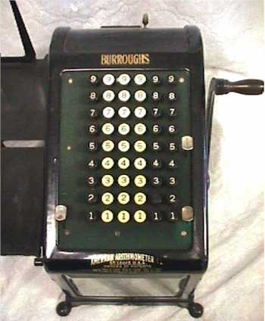
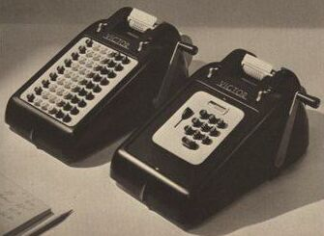
Adding Machines – in pre-calculator times

Slide 8
Evidence of other Number systems in our culture - 12
Duodecimal in use till lately in W Africa
‘The memory of duodecimal system is still vivid. But it will fade away soon, leaving no noticeable trace.’
“Moving from one numeration system to another does not seem to be a "big deal". It can be done within a short timespan, with the slightest push from the socio-economic factor.”
“In this respect, the numerals behave as if they were a part of extra-linguistic institution, like unit of measure, colonial law or some fancy goods in the market. The speakers, also, do not show any real resistance or animosity towards the numeric alteration. Many informants describe, matter-of-factly;
"We used to count in old numbers. But now we count in new numbers.” “

Slide 9
Evidence of other Number systems in our culture - 5
I II III IIII IIII
Counting games
I, II, III, IV, V, VI, VII - Roman cardinal numbers
Abacus
‘Stone Age’ counting systems

Slide 10
Evidence of other Number systems in our culture – 20 (Vigesimal)
Shillings in Pound
Score – ‘4 score years and ten – ‘
Mayan counting system
Base number in French – vingt, quatre-vingt – Danish, and Welsh

Slide 11
Evidence of other Number systems in our culture - 60
The Babylonians used a hexasegimal (base 60) system that was so functional that 4000 years later, we still use it whenever we tell time or refer to degrees of a circle.
One of the main differences between our system and theirs is the number of factors; 1, 2, 3, 4, 5, 6, 10, 12, 15, 20, 30, and 60 for base sixty
Compared with 1, 2, 5, and 10 for base ten.

Slide 12
Roman numerals
II = 2
XXX = 30
XII = 12
CXXIII = 123
XIX = 19
MMV = 2005
MDCCCCLXXXXIX = 1999
Romans knew of zero/place value system, (ie Indo-Arabic) but didn’t adopt it

Slide 13
Zero and Place-value counting
‘The discovery of the zero and the development of the place-value numeration had to wait for a … [good]…. commercial atmosphere. Such a climate took place in India between the first and fifth centuries A.D. It was during that time in India that the zero was discovered and the system of place-value numeration was developed, almost reaching to their fullest formulation by 500 A.D.’
‘Although in recorded history the place-value number systems have been developed four times (by the Babylonians, Mayans, Chinese, and Hindus), and the zero concept has been evolved three times (by the Babylonians, Mayans, and Hindus), none outside of the Hindus have devised such a complete system of numerical operation.’

Slide 14
Perception?
There are limits on both the duration and amount of information we can store in memory at one time. George Miller (1956) showed that the amount is limited to 7 concurrent items +/- 2
Cognitive Load Theory (Sweller, 1988) takes account of the role of working memory
Learning a nonsense word like EHGLP generates a cognitive load of 5; XYTHEWJPH a cognitive load of 9
If a cognitive load is 7 or greater, there is a significant chance that working memory will be overloaded

Slide 15
Perception
Miller’s idea might lead us to think that
  ‘Simpsons’ would be a better counting base than Decimal.
  Duodecimal 12, Vigesimal 20 and sexgesimal 60 are too ‘big’
  What about ‘too small’?

Slide 16
Binary
There are 10 kinds of people in the world; those who understand binary and those who don’t.

Slide 17
Binary Discovery
Binary numbers were discovered in the west by German mathematician Gottfried Leibniz (co-discoverer of calculus with Newton) in 1695. However, new evidence proves that binary numbers were used in India prior to 2nd century A.D., more than 1500 years before their discovery in the west.
Leibnitz predicted that "the calculation, with help of the deuces, i.e. 0 and 1, is basic for science and generates new discoveries, which [will] prove to be useful”

Slide 18
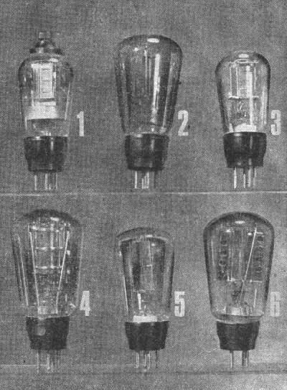
Valve Memory
A VALVE IS A 2-STATE DEVICE:
ON/OFF, 0/1, YES/NO, M/F

Slide 19
First Computers used valves for decimal storage
How is a decimal digit represented?
Need 10 valves for each digit.
- represents a ‘4’

Slide 20
Decimal too unwieldy – Binary!
Leibnitz's prediction was realized in 1947(?) when the American scientist, physicist and mathematician John von Neumann suggested applying the binary number system as the method for computer information coding.
10 Valves with 0001000000 decimal pattern = ‘6’
4 Valves with 1101 binary pattern = ‘13’

Slide 21
Data in Computers
Data are represented by Binary Digits - Bits.
A bit is a 2-state device, which can be interpreted as 0 or 1, on or off, right or left, etc.
All so-called digital data – text, colours, sounds, images – are represented by patterns of 0s and 1s
Since one bit can represent only 2 `things', combinations of bits must be employed to represent numbers (and letters, and other characters)
When we write a number, we do not have any restriction on the number of digits. We can write 2.333333333333 as long as we have room on the page.
However, computer numbers are limited by the number of bits allocated, that is, we have Fixed Length words

Slide 22
Word Length in Computers
How many things can we represent with a ‘word’ of 2 bits?
3 bits?
4 bits?
00, 01, 10, 11
000, 001, 010, 011, 100, 101, 110, 111
0000, 0001, 0010, 0011, 0100, 0101, 0110, 0111, 1000, 1001, 1010, 1011, 1100, 1101, 1110, 1111

Slide 23
Word Length in Computers
How many symbols do we need to carry out such diverse exercises as keeping financial accounts or writing love letters?
52 letters, 10 digits and 20 (say) characters such as ? % , . : ; £ $ & - + ( )
How many bits are required to hold each of these ~82 characters in a unique pattern?
7 (seven) bits can have 128 unique patterns
8 bits (byte) can represent 256 different entities

Slide 24
Character Representation in Computers
8 bits – one byte - is the standard character length in computers
The 7 bit ASCII code is a standard code to represent our alphabet, digits, and special characters
The ASCII code has been extended to 8 bits, includes some European symbols such as é, ç
EBCDIC (Extended Binary Coded Decimal Interchange Code) is a true 8-bit code used in IBM Mainframe computers

Slide 25
Character Representation in Computers
To represent other alphabets in the world, a new 16 bit representation has been introduced – Unicode
Unicode is an evolving standard – in version 2.0, there are 38,885 distinct coded characters
Intended to represent all the written languages in the world
‘There are reckoned to be about 65 alphabets in active service at the moment throughout the linguistic universe.’

Slide 26
How does computer know how to deal with a binary pattern?
1000 0111 1001 1100 1101 1100 0000 0000
Is it text, image, video, sound, or a number?
Different file extensions indicate how data should be treated. SOME examples:
Text .doc .txt
Sound .mp3 .wav
Image .jpg .bmp .gif
Video .avi .mpg

Slide 27
How do we relate binary patterns to one another?
That is, how do human beings exchange or memorise long binary strings eg 00110100011000111?
We break it up into groups of four
Give each 4-bit group a hexadecimal (hex) base 16 value
Hex is a shorthand way of expressing the contents of a binary pattern (see Miller’s rule!)
0011 1000 1100 1010
3 8 C A
Computer addresses are expressed in Hex

Slide 28
Summary
Numbers in computers have fixed lengths; 16-bit and 32-bit integers are common
We need at least 6 bits to represent a human-compatible (Latin) symbol; most common encoding for symbols is ASCII, which takes 7 bits – extended to the 8-bit byte, the basic unit of computer storage.
Hexadecimal is shorthand for binary patterns
All data in computers held as 0s and 1s – the word ‘Digital’ means ‘represented by bits’.

